Slide 1
Introduction to CSCE 110
Dr. Tim McGuire Grateful acknowledgement to David Kebo Houngninou for some of the material contained in these slides

Slide 2
Course Introduction
Programming, instructions, algorithms, interpreter

Slide 3
What is programming?
Programming is the action of writing code to give a computer instructions to perform some tasks.

Slide 4
What is programming?
a = int(input())
b = int(input())
sum = a + b
print (sum)
5
3
8

Slide 5
To program is to solve problems
Problem
Design a solution
Implement a solution
1
2
3

Slide 6
What is a programming Language?
A programming language is a formal language.
Programming languages specify a set of instructions that can be used to perform various actions.
Programming languages are used to create programs.
Notes:
Natural languages are the languages that people speak, such as English, Spanish, and French.
Formal languages are languages that are designed by people for specific applications.
An instruction is a single operation of a processor defined by the processor instruction set

Slide 7
Programming languages classification

Slide 8
Programming languages classification

Slide 9
What is the best way to learn a language?
Notes:
Use it !

Slide 10
What is an algorithm?
An algorithm is a finite sequence of steps that solves a problem.
Computational complexity:
How long (time) and how much memory (space) does it take?
We observe the behavior of algorithms as the input size grows

Slide 11
Example
Given a list of positive numbers, return the largest number on the list.
Set the maximum to the first number.
Compare the maximum to the next number in the list .
If the next number is greater than the maximum then update the maximum.
Repeat step 2 until the end of the list.
Notes:
Algorithm:
- Set max to 0.
- For each number x in the list L, compare it to max. If x is larger, set max to x.
- Max is now set to the largest number in the list.

Slide 12
Example
Given a list of positive numbers, return the largest number on the list.
3, 5, 7, 1, 4, 9, 2
Notes:
Algorithm:
- Set max to 0.
- For each number x in the list L, compare it to max. If x is larger, set max to x.
- Max is now set to the largest number in the list.

Slide 13
Example
List 5 programming languages
Python
Java
PHP
C#
C++
List 5 algorithms
Maximum-finding
Linear search
Binary search
Bubble sort
Insertion sort
Notes:
C, C++, Java, Python, Objective-C, PHP, C#, Swift, Ruby
Maximum finding algorithm, Linear search, Binary search, Bubble sort, Insertion sort, Merge Sort

Slide 14
How is code executed?
Processor
ARM
Code
.c, .c++ ...
Compiler
Machine
code
01010
Processor
Intel 8086
Processor
IBM PowerPC
Notes:
Lexical analysis: Generates a stream of lexical tokens
Syntactical analysis: uses the rules of grammar to decide whether the input is valid or not
Compiler: Translates code into assembly code
Assembler: Translates code into machine code. The resulting file is called an object file
Linker: The linker links with other object files and libraries and produces a binary executable
Loader: loads all of them into memory and then the program is executed.

Slide 15
How is Python code executed?
Processor
ARM
Code
.py
Interpreter
Processor
Intel 8086
Runtime libraries
Processor
IBM PowerPC

Slide 16
Compiler vs. Interpreter
A compiler is a computer program that converts an entire program into binary code (machine code) targeted to a specific CPU.
An interpreter is a computer program that directly executes instructions written in a programming or scripting language, without compiling it into machine code.

Slide 17
Interpreter vs. compiler
Interpreting code is different from compiling code.
The interpreter executes one instruction at a time.
Interpreter | Compiler
Translates program one statement at a time. | Scans the entire program and translates it as into machine code.
No intermediate object code is generated | Generates intermediate object code
Continues translating the program until the first error occurs | Generates the error message only after scanning the whole program.
Python, Ruby, Perl, MATLAB etc. | C, C++ etc.

Slide 18
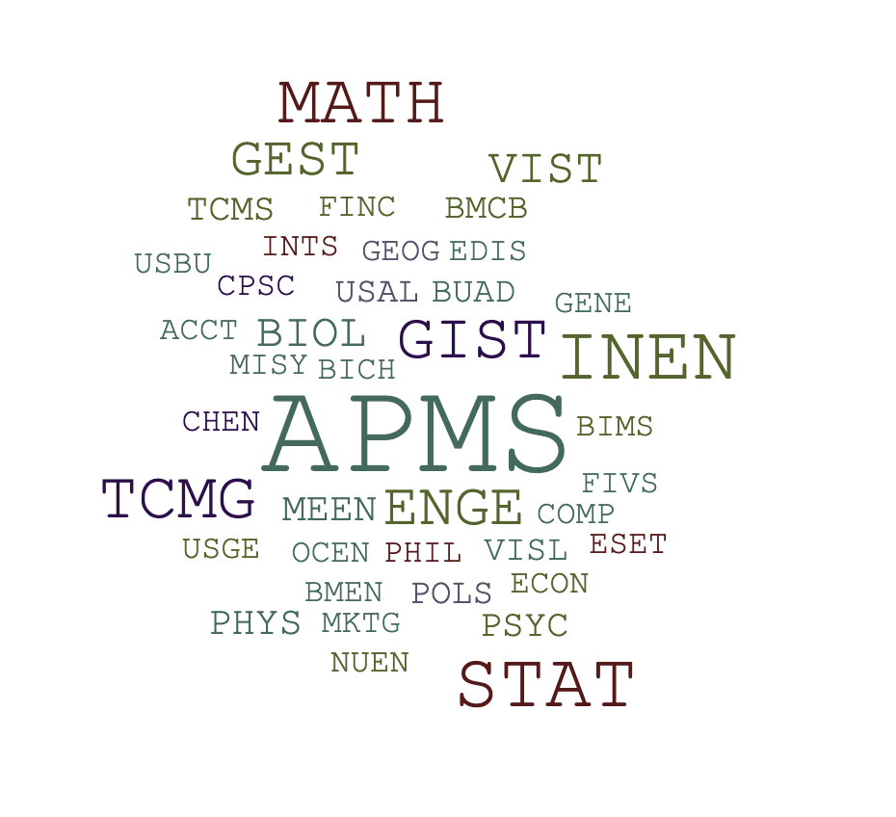
Why Python?

Slide 19
Why Python?
Easy to learn
Solve problems in less time, fewer lines of code
Elegant, intuitive syntax and dynamic typing
Efficient high-level data structures
Ideal for scripting and rapid application development
Notes:
Dynamically typed languages only figure out the types of variables at runtime.

Slide 20
Applications of Python
Machine learning
Data Science
Visualization
Web Applications
Notes:
Pandas
Numpy an Scipy
Matplotlib
Django

Slide 21
Summary
What is programming?
What is a programming language?
Programming languages classification

Slide 22
How to configure your computer?

Slide 23
1. Install the Python distribution
Anaconda is a free open source python distribution that provides packages and libraries out of the box for data science.
Install Anaconda (Python 3.7 version)
https://www.anaconda.com/products/individual
The core python language
Python packages/libraries
Package manager
Notes:
A distribution is a collection of software components built, assembled and configured so that it can be used essentially "as is" for its intended purpose.

Slide 24
2. Install the IDE
An Integrated Development Environment (IDE) is a software application that provides comprehensive facilities to computer programmers for software development.
Install PyCharm (Community version)
https://www.jetbrains.com/pycharm/download/
An editor designed to handle code
Build, execution, and debugging tools
Version control

Slide 25
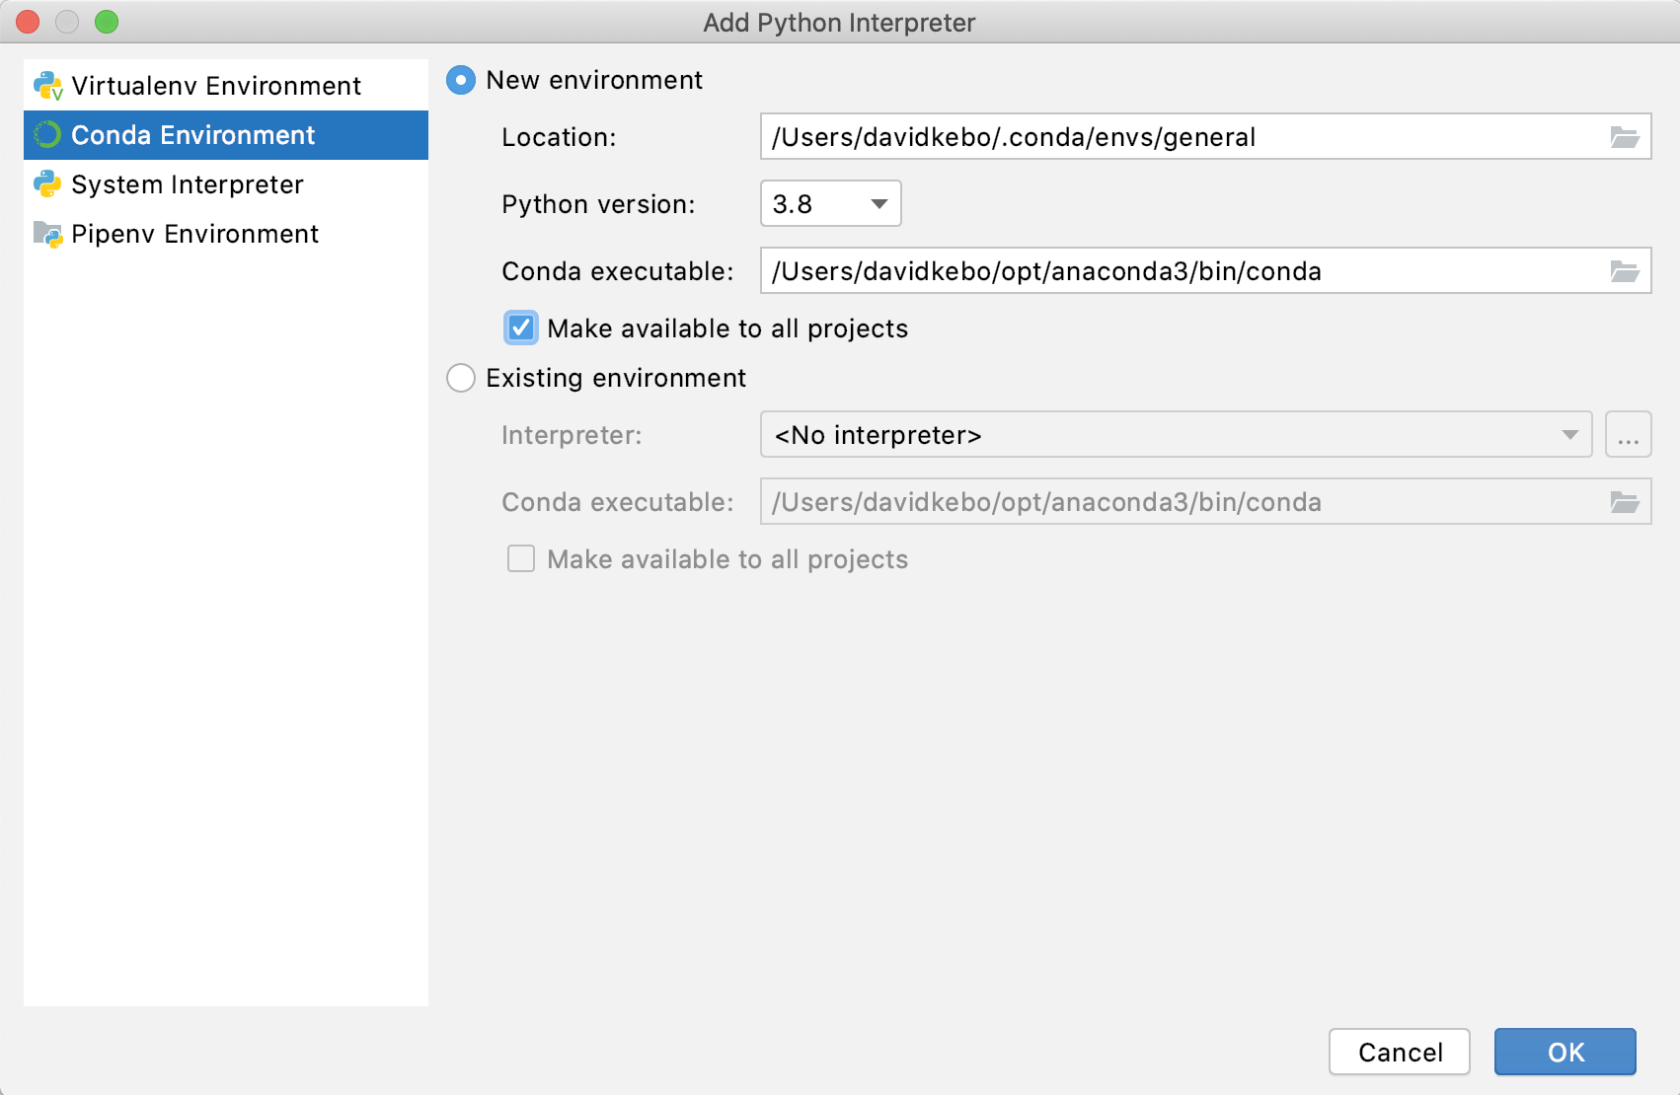
2. Install the IDE

Slide 26
2. Install the IDE
The PyCharm community version is open-source and free.
It is available for major operating systems:
Windows
MAC
Linux

Slide 27
About Python
Python was developed in 1989 by Guido van Rossum in the Netherlands.
Python was released for public distribution in early 1991.

Slide 28
How did Python begin?
van Rossum was having a hard time getting the job done with the existing tools available.
He envisioned that there was an easier way to get things done.
Python has been around for over 30 years, it is still relatively new to general software development.
Python has lots of support from the community.

Slide 29
End

